Slide 1
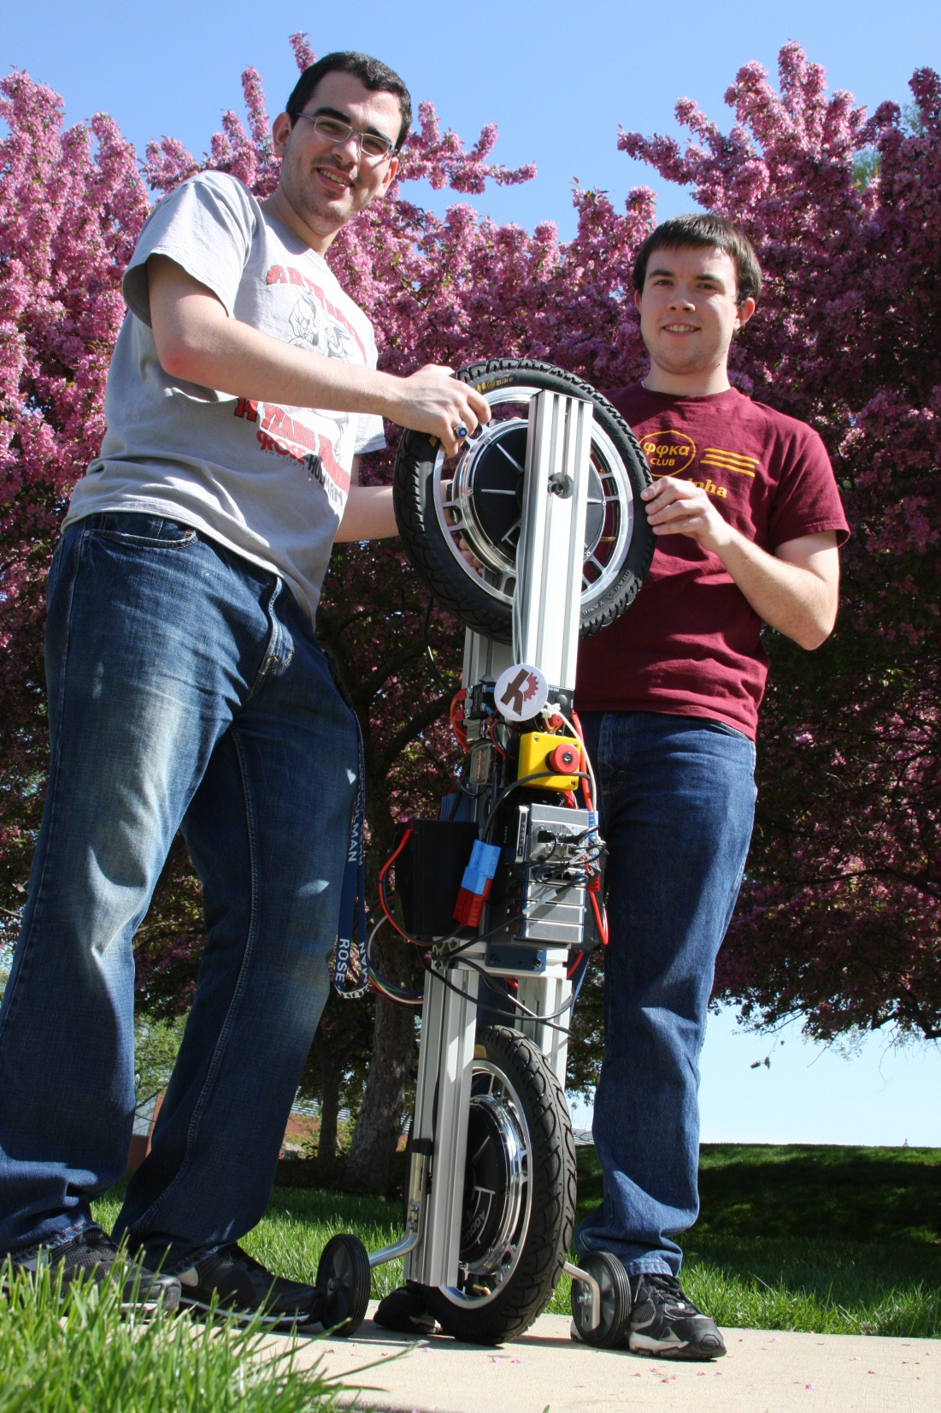
Simple Operation Manual
For Robotic Unicycle Demo
Team G

Slide 2
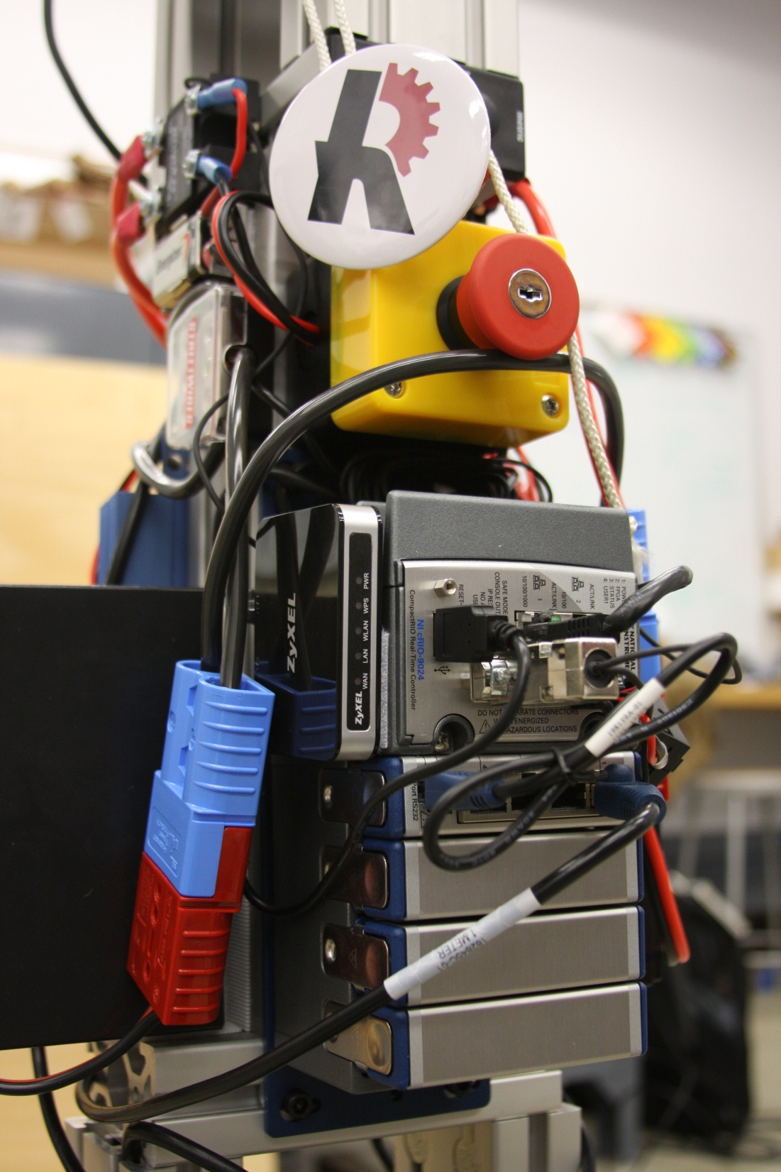
Index
Safety
Quick Start
Assembly
Maintenance
Charging
Demoing
Requisites
Power Up
Connecting
Deploying
Notes

Slide 3
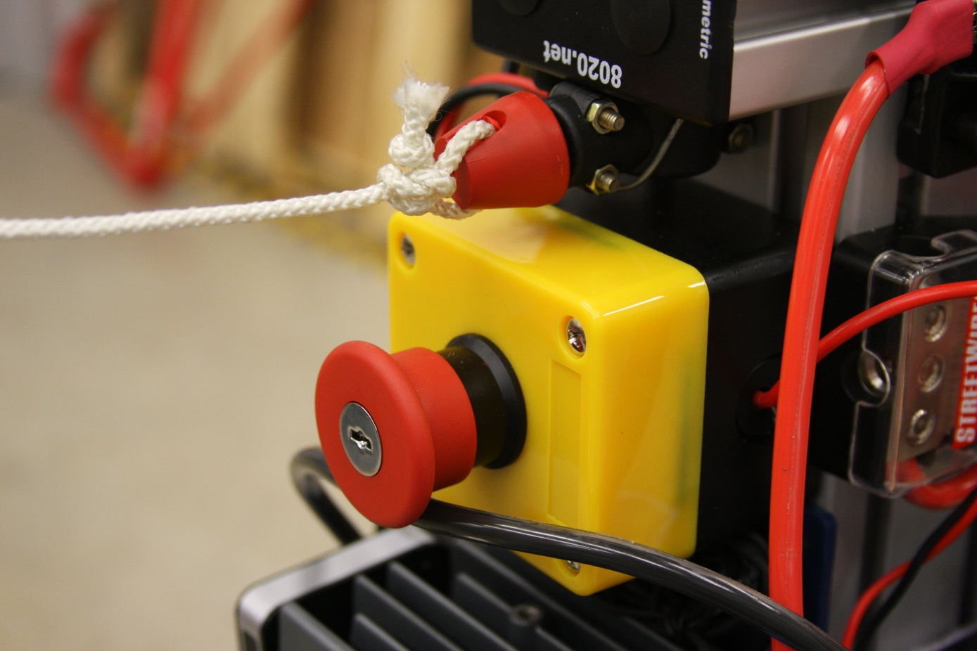
Safety
Before Operation Become familiar with the following:
Kill Switch
Keyed Reset
Kill Cord

Slide 4

Safety
Both the kill switch and kill cord are in series with the signal reference voltage for the Solid State Relay. This is so that in the even that if either one of the E-stop measures are tripped, current delivered to the motor controller will be stopped immediately.
The Kill switch has a keyed lock access, preventing the switch from being reset and used without proper authorization.
The Kill cord has a small rubber cap this is used to depress an internal normally open switch. In the event the robot falls away from the user with the kill switch out of reach, the robot can still be stopped by yanking the cord.
The kill switch box also happens to have a replicable 5A automotive fuse in the case that the signal reference voltage is accidently shorted.

Slide 5
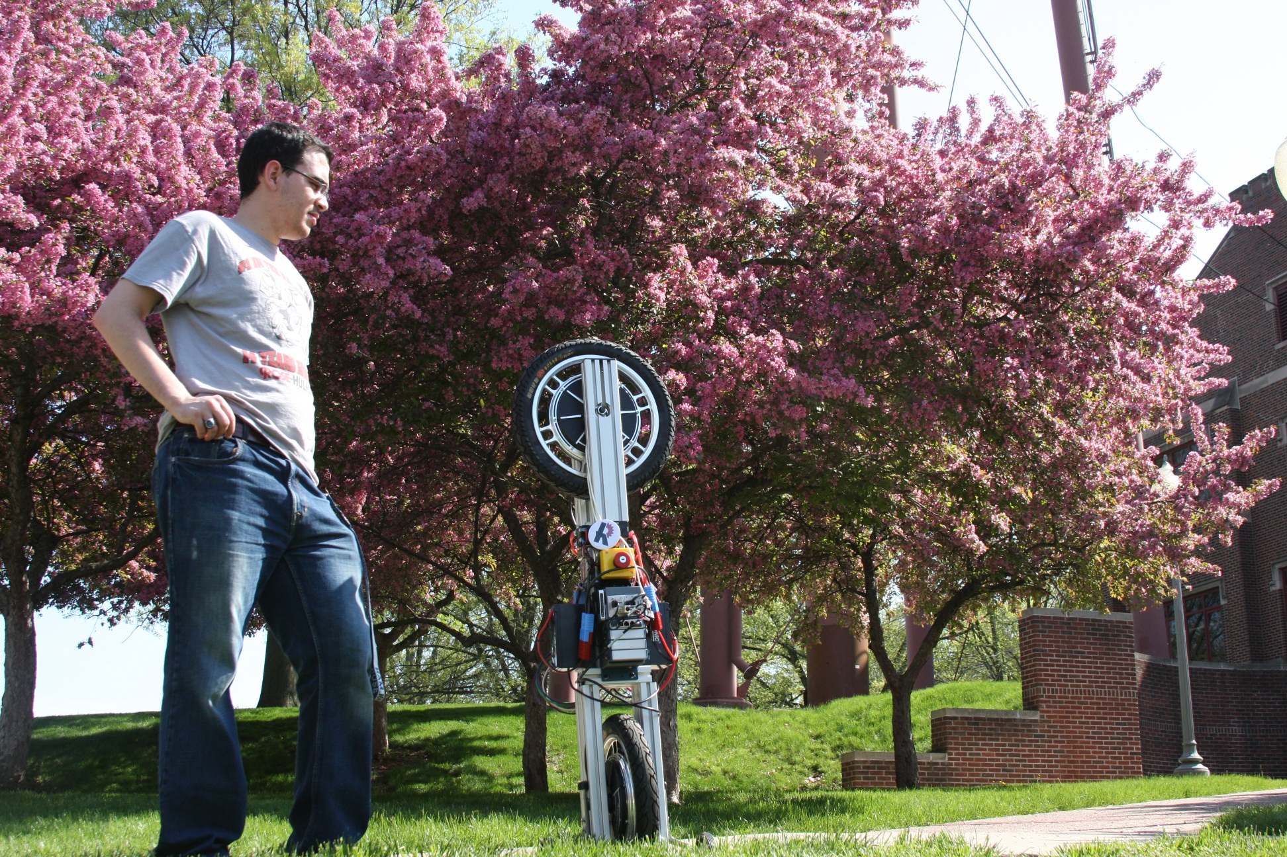
Quick Start
How to quickly get your robotic unicycle up and running

Slide 6
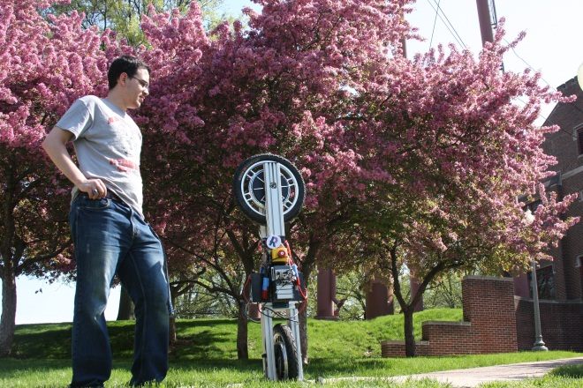
Quick Start
Check List
You have suitable space to demo
Hub-motors are secure and spin freely
Batteries are fully charged
Circuit breaker and E-stops are not tripped
Open LabVIEW project Code
Connect to UniCyRO WiFi and the cRIO
Deploy the Main.vi to the cRIO
Have someone spotting the robot
Then enable the balance control with front panel UI

Slide 7
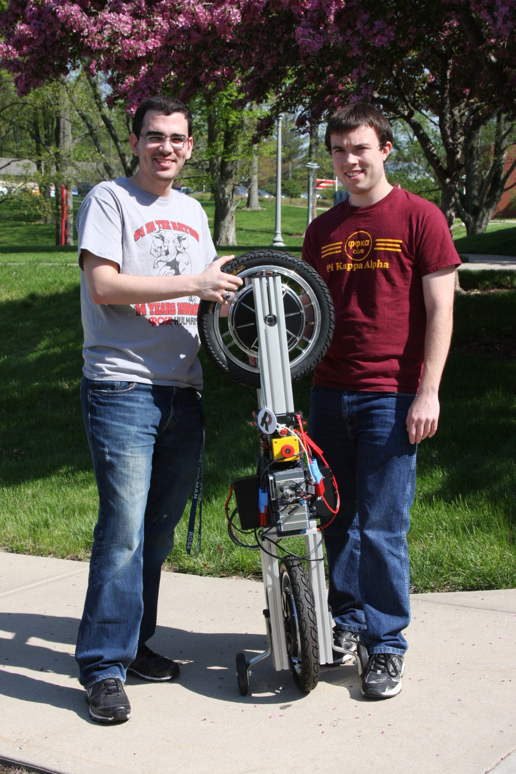
Assembly
Frame
Motors
Electronics

Slide 8
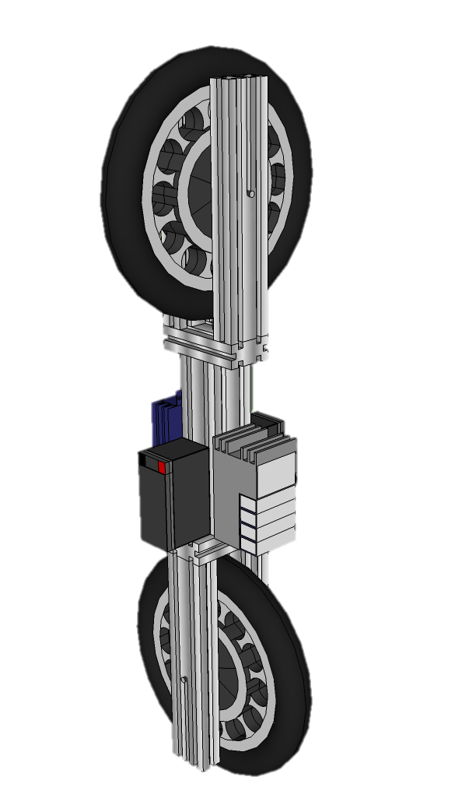
Assembly
Frame
For convenient assembly, the robot is constructed out of 80x20 aluminum framing. This “T” slotted aluminum extrusion is used so that mounted components could be easily attached and adjusted.
On either end of the center column of the frame are two orthogonal forks that serve as mountings for the bicycle hub motors. For disassembly and shipment these hub motors are also detachable from both the motor controller and the frame. Similar to bicycles, but on a longer dimension, the two forks include channels for which the keyed shafts of the tires to slide in and out of place. Using a large set of pliers, one can either tighten or loosen the threaded shaft of the tiers for assembly.

Slide 9
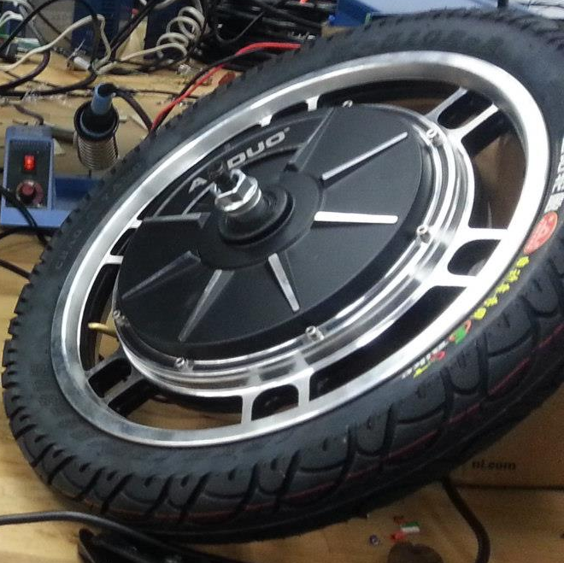
Assembly
Motors
The motors on the robot are in fact Chinese E bike hub motors used in electrifying bicycles and motorized scooters. Similar to buy tires, the motors use keyed threaded shafts to interconnect with a mounting fixture. Because the forks that tighten around the shaft, it is important that the shaft and spacers are properly lubricated to prevent large amounts of static friction. Static friction buildup can slow response times and dampen control effort reducing the stability of the unicycle.
The motors interface with the RoboteQ motor controller poll conductors for three phase power and a DB9 connector for hall sensor feedback. The connectors are color-coded to prevent accidentally swapping channel connections.

Slide 10
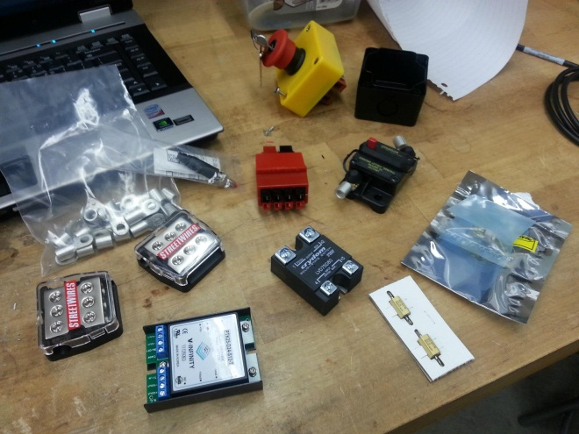
Assembly
Electronics
Electronics assembly is constructed set of lose wiring and slaked cables. This was intended to allow the components to have a tolerance of adjustability when fine tuning the center of gravity of the entire robot.
Providing power are to 12 V 7.5 Ahr sealed lead acid batteries in series to create a combined 24 V supply. This voltage range is suitable for the cRIO and RoboteQ controller operation. In series with the 24 V supply is a 70 A circuit breaker to protect the batteries and electronics accidental short-circuits and excessive current draw.
Smaller electronics such as the Inertial Measurement Unit and Wi-Fi router are powered off from an onboard 12 V out DC DC converter and the cRIO’s 5 V USB supply respectively.

Slide 11
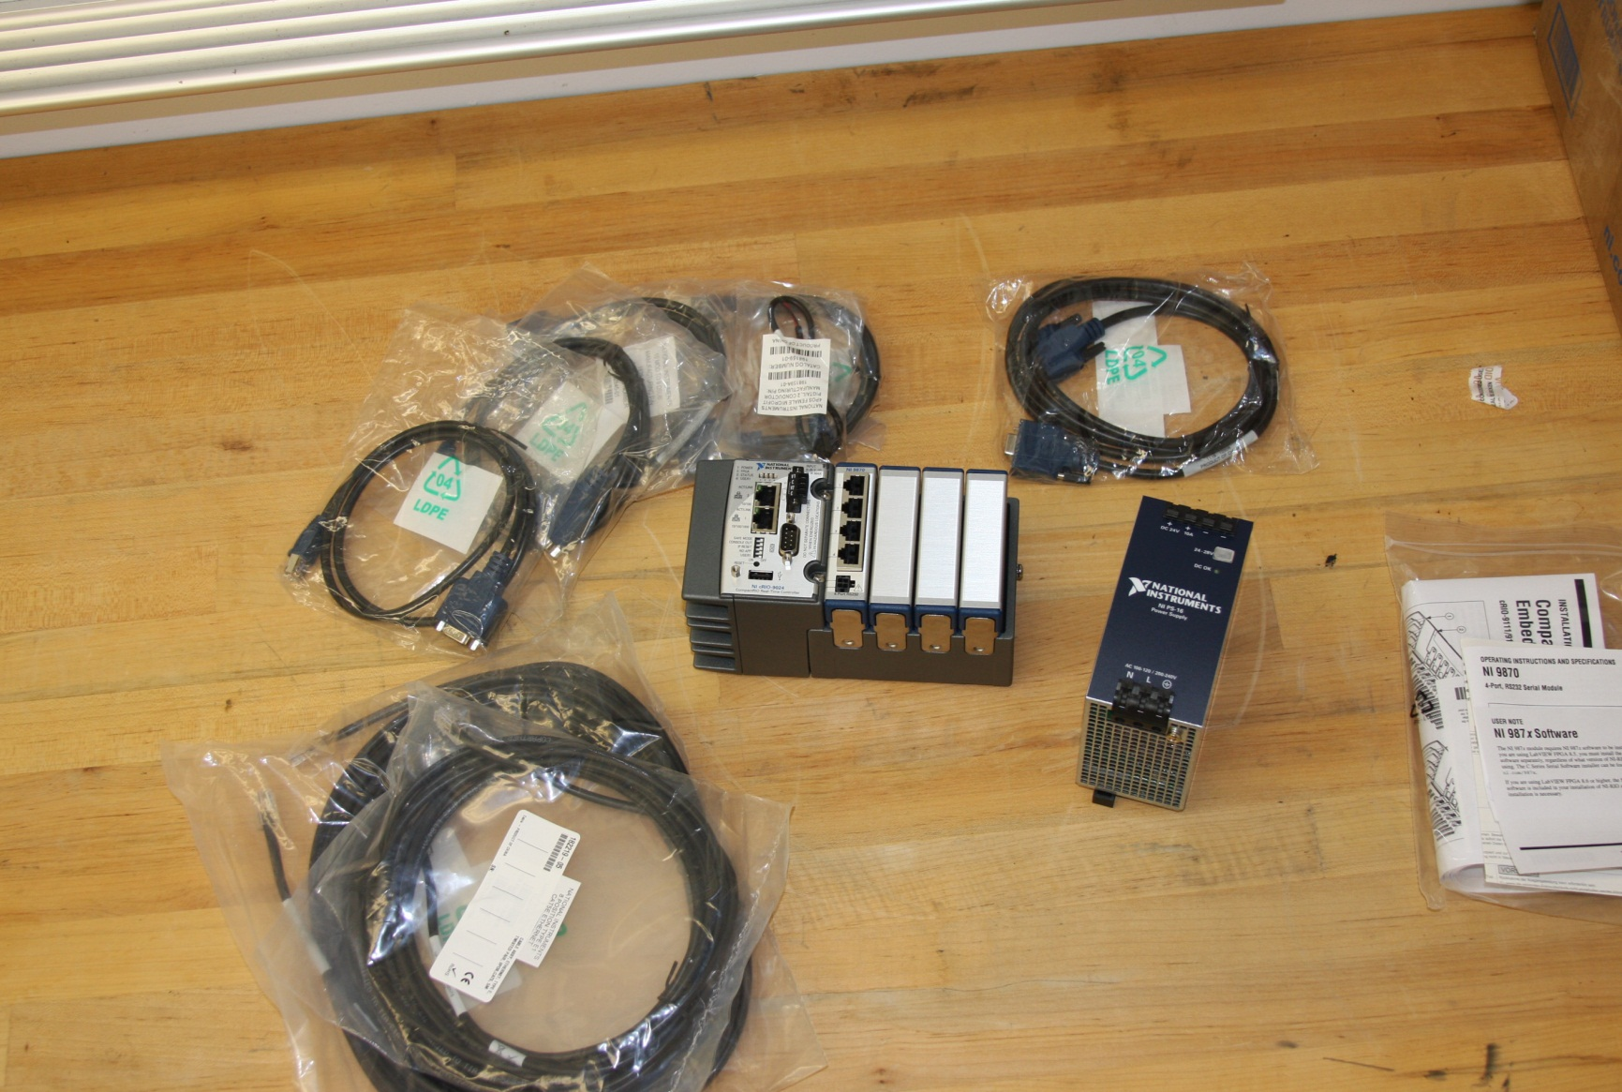
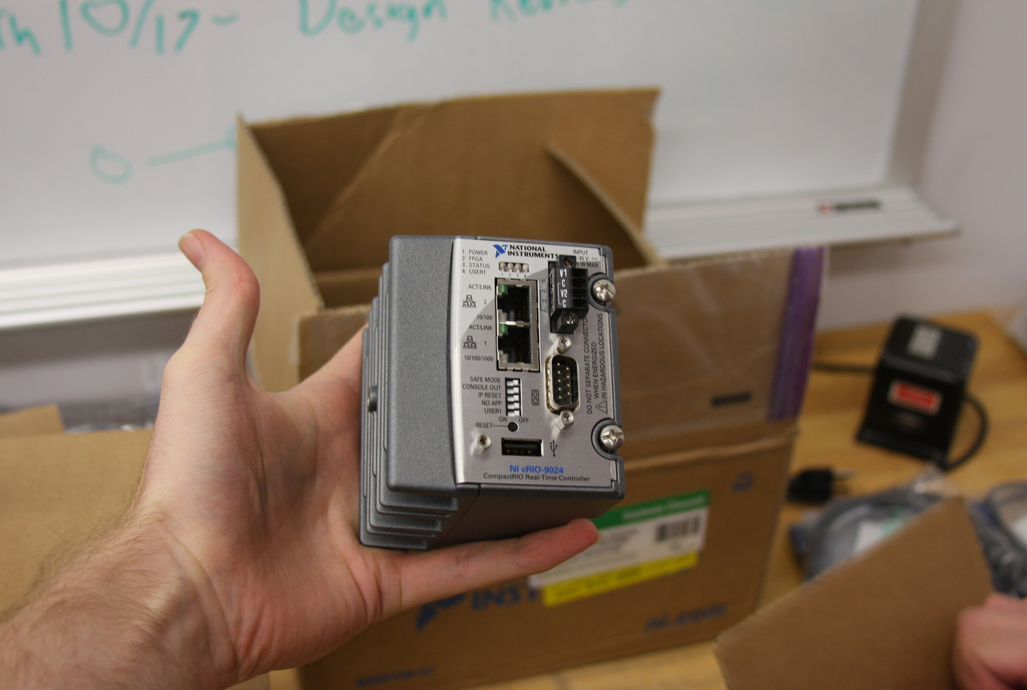
Assembly
Electronics
National Instruments cRIO
The cRIO uses several communication interfaces.
The Ethernet port 1 is used to program the real-time platform over the wireless network.
And RS-232 to communicate with the IMU and RoboteQ over the internal and external 9870 serial connections respectively.

Slide 12
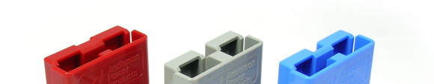
Maintenance
Charging
The batteries are supplied with large power red pole connectors. These connectors are color-coded and are limited in there interconnect ability to prevent misuse.
The red power pole connectors can be connected to either the grey connectors for charging, or the blue connectors for robot operation. Do not try to power the robot with the charger, charger is not designed to supply the required current and may not be meant to be connected in series with itself.

Slide 13
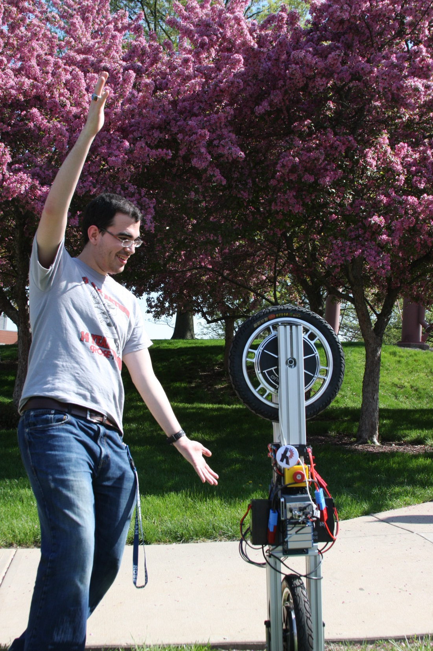
Demoing
How to demo the robot
In detail

Slide 14

Demoing
Requisites
Make sure you have suitable space to demo. The robot require some space to stabilize as well as potential room to fall unobstructed by bystanders.
Hub-motors are need to be secure and spin freely. If the static friction is too great or the slip between the key shaft and fork will make it difficult or impossible for the controller to adequately actuate its corrective efforts for a steady-state balance.
Batteries are fully charged. The performance of the power output to the motors as well as expected voltage ranges for other electronics are dependent upon the terminal voltage of the lead acid batteries.
Circuit breaker and E-stops are not tripped. It is possible to leave the E-stop engaged throughout the start process as a safety measure, just remember to disengage it prior to enabling the main vi controller. With the circuit breaker closed, we will assume that the robot is now under power.

Slide 15

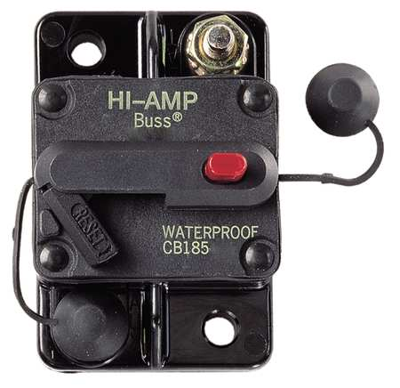
Demoing
Power Up
Make sure the reset latch for the circuit breaker is engaged or recessed into place.
The kill switch button is reset and extended outward.
The kill court rubber knob is firmly pushed back into place.

Slide 16
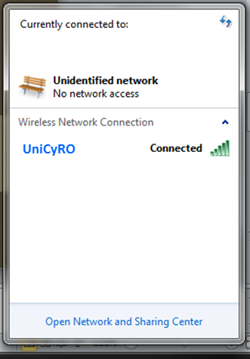
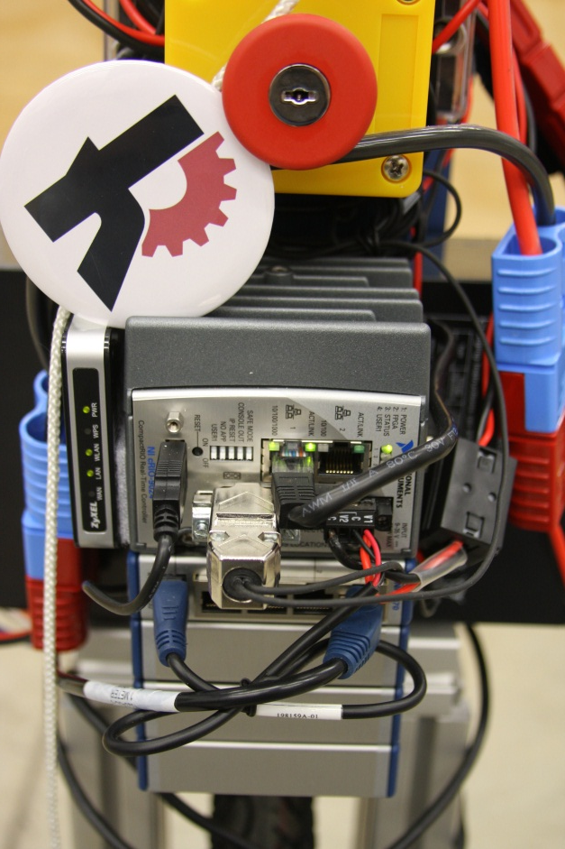
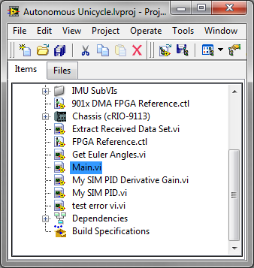
Demoing
Connecting
Connect to the Robots WiFi network, “UniCyRO”
Password: rhitni13
Open up the project
Open the Main.vi

Slide 17
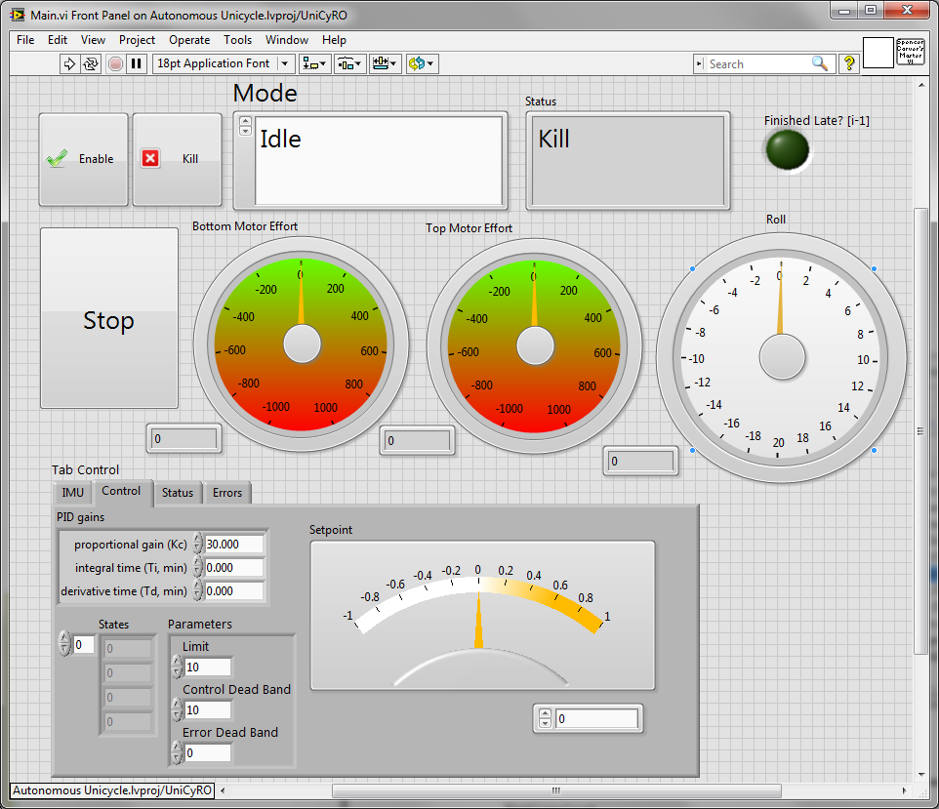
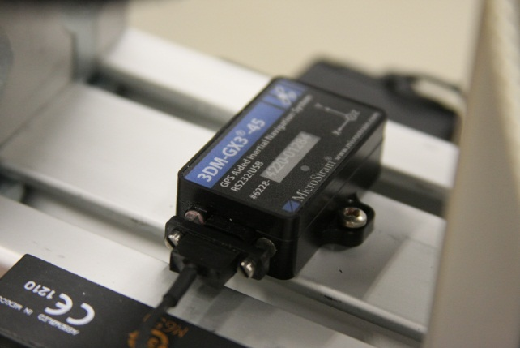
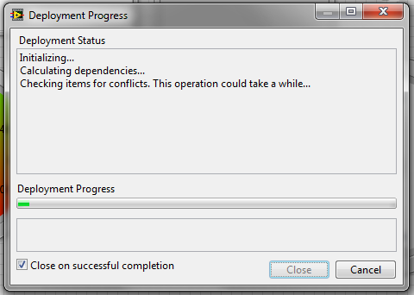
Demoing
Deploying
Hit the run button
Wait to connect
Zero out IMU bias
Adjust Setpoint so it match's the upright roll reading
Helps to have some spot the robot upright while you calibrate

Slide 18
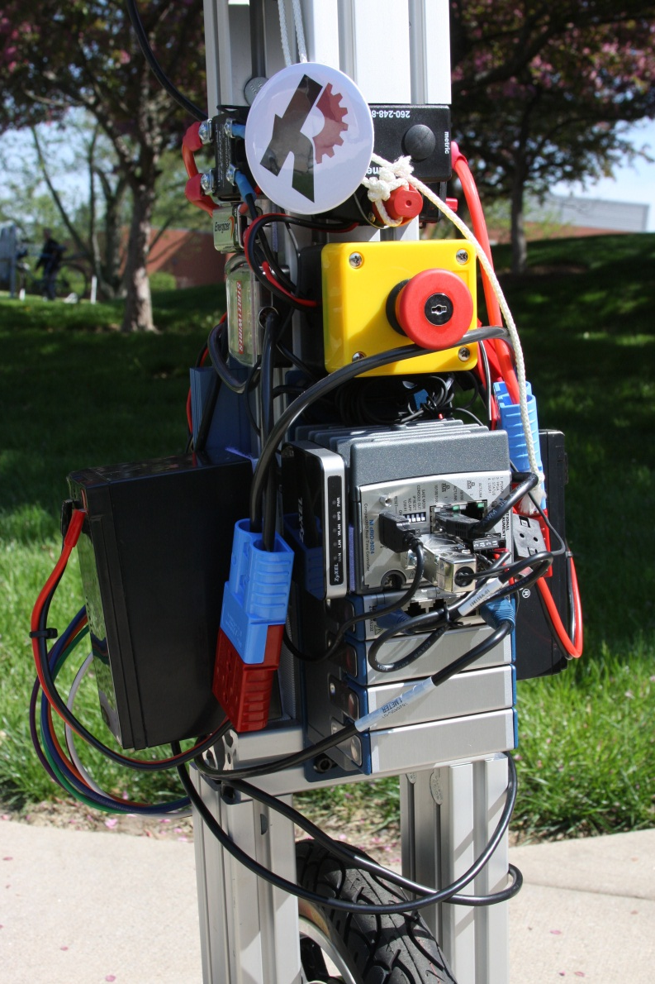
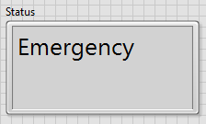
Demoing
Running
Be sure to know the behavior of the supporting finite state machine of the controller. Should robot tilt beyond a point of no return, a configurable limit within the front panel, the robot will enter an emergency state. This will lock the controller and motors until tell the enabled button is toggle or cycled.

Slide 19
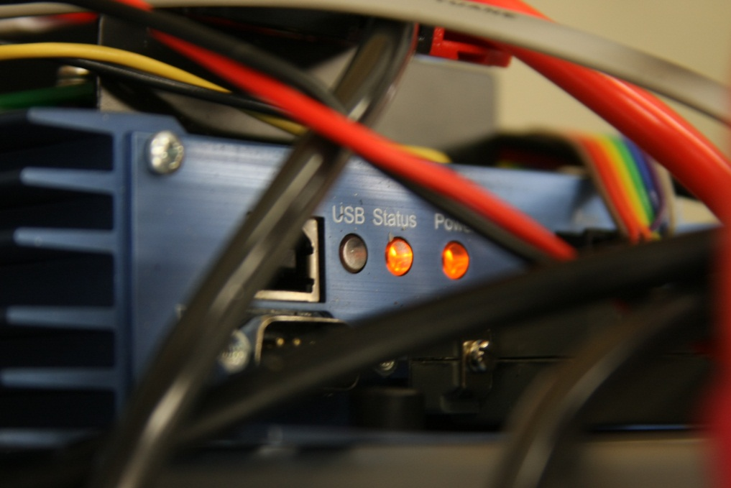


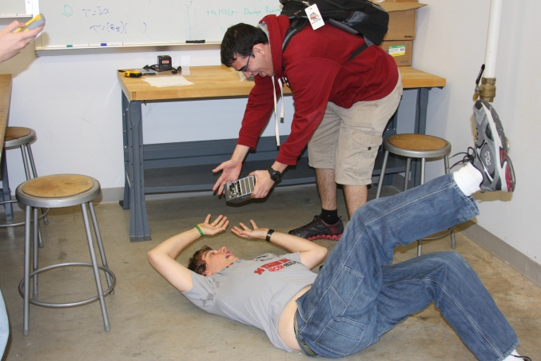
Notes
Debugging
An device not working
Does it have proper voltage supply?
What does its status indicator say? (device specific documentation in the repo)
Is the E-Stop triggered
Is the 9V battery for SSR signal boost dead or backwards?
Is the controller or sensor loaded with the right configuration file? (configuration files in the repo)
Also
Pease be carful with to robot
Even if the components used are durable and a the safety fixture is mounted, its best to be safe than sorry. So try your best to watch out for our little robot.

